Slide 1
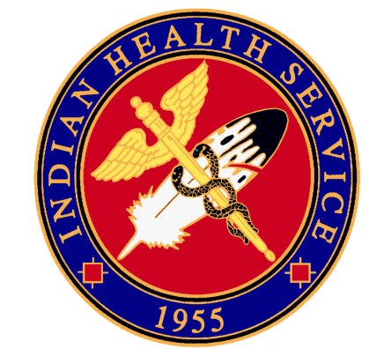
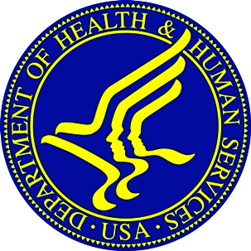
Indian Health Service
Portland Area Director’s Update
Dean M Seyler - Area Director
April 17, 2012
Quarterly Board Meeting
Quinault Beach Resort & Casino

Slide 2
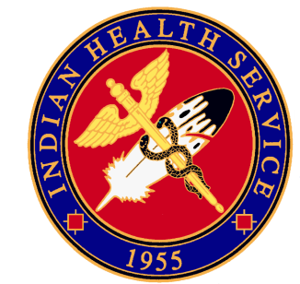

Renew And Strengthen Our Partnership With Tribes
638 Orientation Occurred February 28th & 29th
  30 Participants
  Next Session?
Direct Service Tribes Area Meeting
  March 22nd and 23rd
  Next session at Tribal location
  Annual or Semiannual?

Slide 3
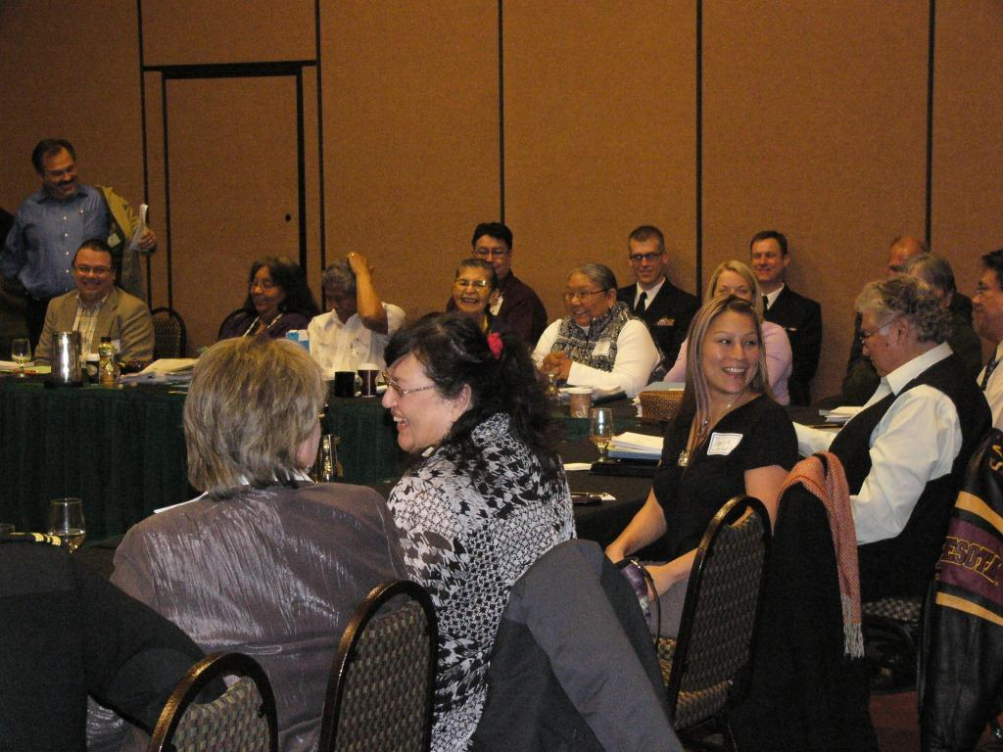
DST Meeting
March 22nd & 23rd

Slide 4
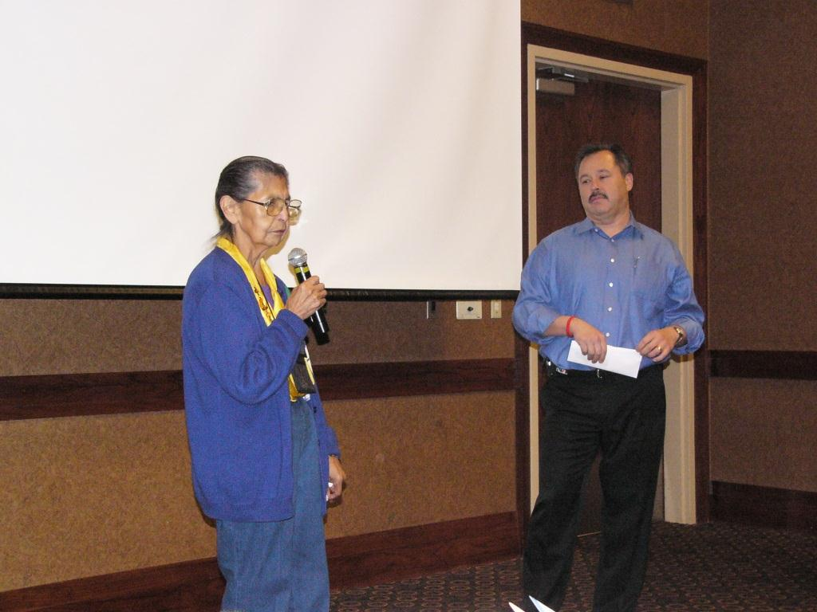
DST Meeting

Slide 5
Renew And Strengthen Our Partnership With Tribes
Urban Directors Meeting
  March 8th and 9th
  Annual Event
Office of Tribal Government Relations (OTGR) Western Region Quarterly Conference (VA)
  April 10th & 11th
Portland Area Facilities Advisory Committee
  Request made to Headquarters for assistance on next phase

Slide 6
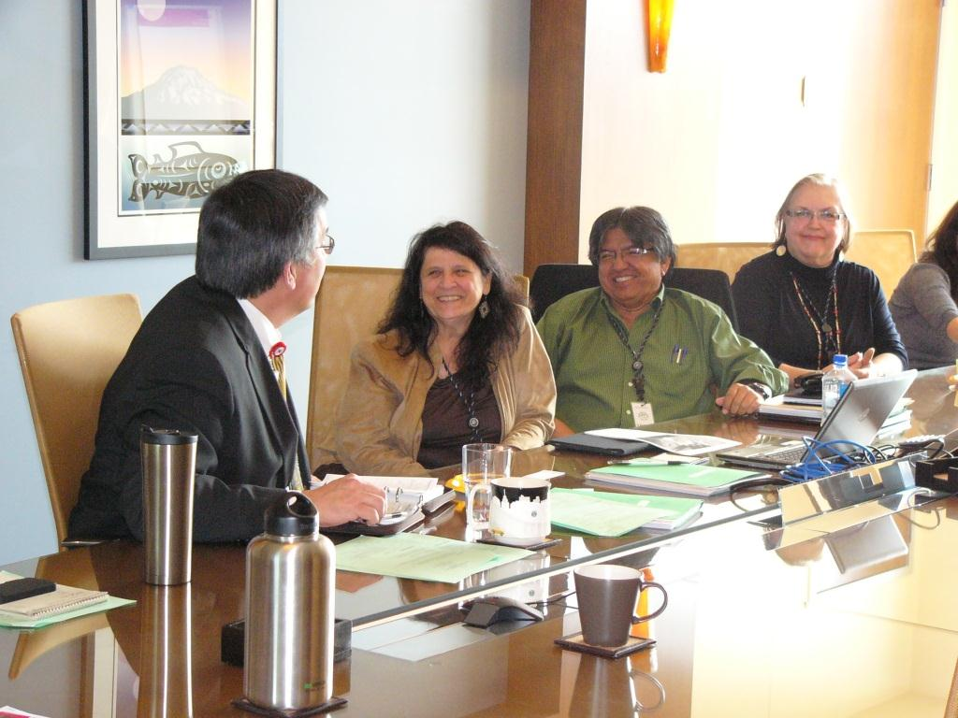
Urban Meeting
March 8th and 9th

Slide 7
Renew And Strengthen Our Partnership With Tribes
2nd IHS Tribal Consultation Summit –August 7th & 8th in Denver, Colorado
  Andy Joseph Jr.
  Julia Davis-Wheeler
ICD-10
  10 Tribal Sites
  1 Urban Program
  All Federal Sites

Slide 8
Renew And Strengthen Our Partnership With Tribes
Fund Distribution Workgroup
  Contract Health Funds
  Charter Update
Portland Area Facilities Advisory Committee
  Request made to Headquarters for assistance on next phase

Slide 9
To Reform The IHS
Staff Update:
  Chief Medical Officer (CMO) - Portland Area
    Acting CMO
  Meaningful Use Coordinator
IHS Administrative Review – May 2012
Recognition of Excellence – May 4th.

Slide 10
Improve The Quality Of And Access To Care
Nespelem Dental Facilities
Yakama Renovation of Space Continues
  New Pharmacy Space
  Contract Health Space will be relocated

Slide 11
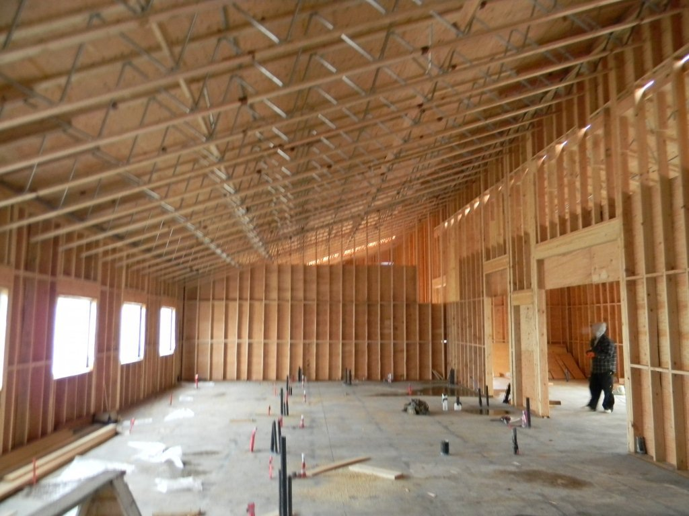
Improve The Quality Of And Access To Care

Slide 12
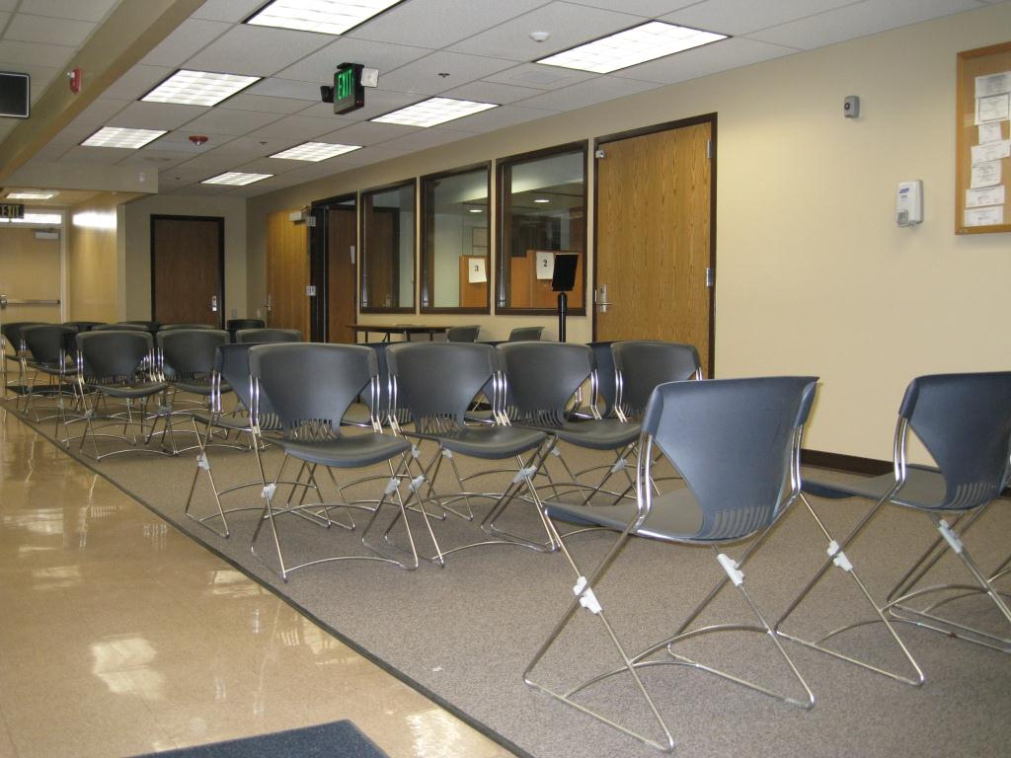
Improve The Quality Of And Access To Care

Slide 13
Improve The Quality Of And Access To Care
Tribal Access to e-Prescribing Network
Yakama Service Unit pharmacy started using the Veterans Administration Consolidated Mail Outpatient Pharmacy (VA-CMOP)
Walter Reed Army Medical Center Transfers $1.2M Excess Medical Equipment to IHS

Slide 14
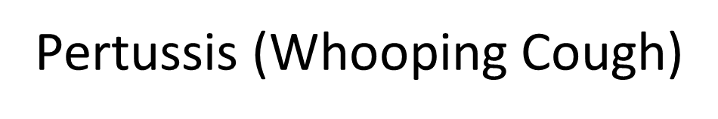
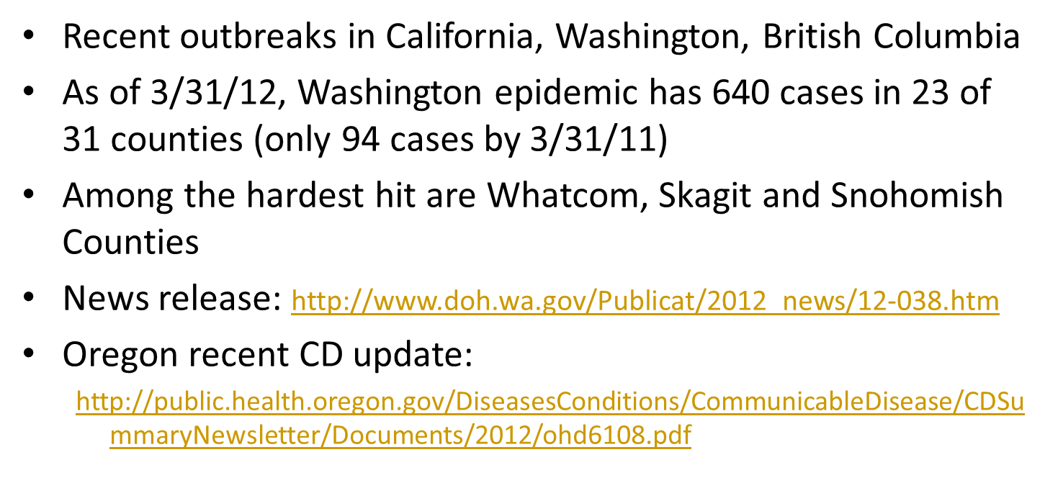
Improve The Quality Of And Access To Care

Slide 15
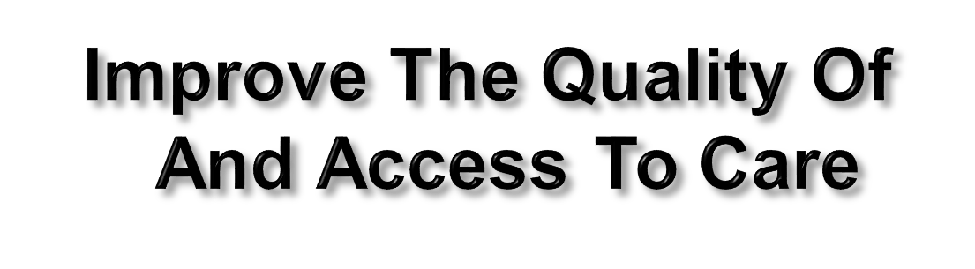
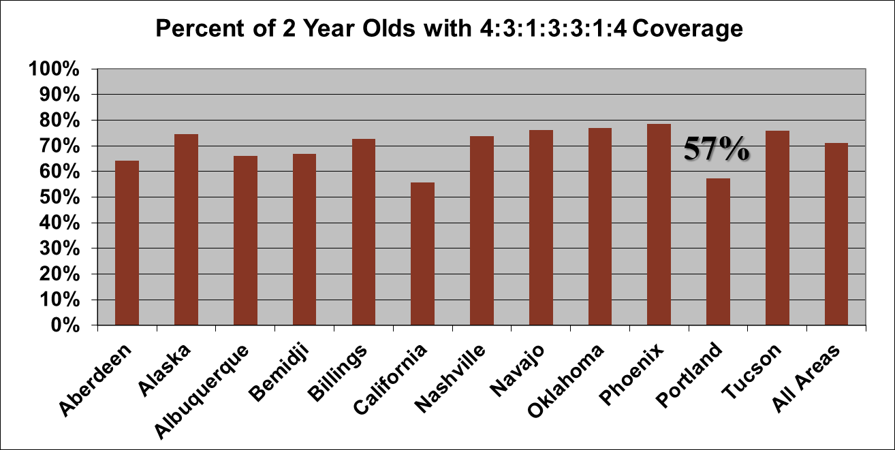


Slide 16
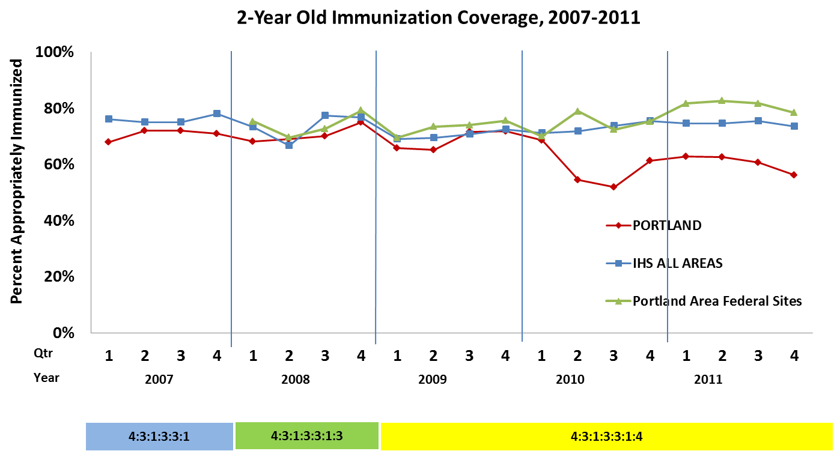

Slide 17
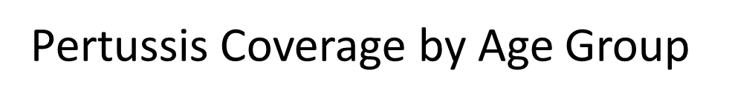


Age | Portland | National (IHS) | Number of DTAP Doses
3-4 m | 67% | 84% | 1
5-6 m | 58% | 69% | 2
7-15 m | 60% | 75% | 3
16-18 m | 74% | 88% | 3
19-23 m | 62% | 73% | 4
24-27 m | 70% | 82% | 4
13 year olds | 85% | 85% | 1 (Tdap)

Slide 18
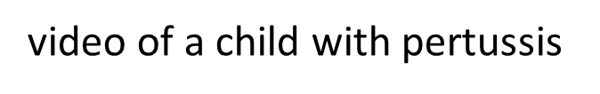

Slide 19
Ensure that our work is transparent, accountable, fair, and inclusive
IHS Budget At A Glance
FY 2009 – 7% increase
FY 2010 – 13% increase
FY 2011 – 0.4% increase ($17 million)
FY 2012 – 5.8% increase ($237 million)
  $4.3 billion overall budget

Slide 20
Ensure that our work is transparent, accountable, fair, and inclusive
IHS Budget At A Glance
Since 2008:
  Overall IHS Budget increased 29%
  Contract Health Service (CHS) budget has increased 46%
  Contract Support Costs (CSC) funding has increased 76%
  Dental and mental health funding have increased 19%
  Health care facility construction funding has increased 132%

Slide 21
INDIAN HEALTH SERVICE
PORTLAND AREA OFFICE
Budget Comparison
FY 2008 - FY 2012
 |  | FY 2008 | FY2012 | % Change
TOTAL PORTLAND AREA BUDGET |  | 217,710,910 | 262,224,906 | 17.0%
SERVICES APPROPRIATION |  | 205,913,598 | 249,934,988 | 21.4%
Clinical | Hospitals and Clinics | 65,292,233 | 77,046,372 | 18.0%
 | Contract Health Services
 | CHS only | 63,536,339 | 83,160,509 | 30.9%
 | CHEF only (actual reimbursement) | 1,667,053 | 3,188,950 | 91.3%
 | Dental | 7,106,960 | 7,789,740 | 9.6%
 | Mental Health | 3,869,417 | 4,192,134 | 8.3%
 | Alcohol & Substance Abuse | 15,249,990 | 16,697,051 | 9.5%
 | Sub-total Clinical | 156,721,992 | 192,074,756 | 22.6%
Preventive | Public Health Nursing | 2,750,381 | 3,002,331 | 9.2%
 | Health Education | 870,534 | 952,090 | 9.4%
 | Community Health Representatives | 4,304,058 | 4,709,214 | 9.4%
 | Alaska Immunizations | - | -
 | Sub-total Preventive | 7,924,973 | 8,663,635 | 9.3%
Other | Urban | 4,706,969 | 5,520,701 | 17.3%
 | Indian Health Professions | - | -
 | Tribal Management Grants | - | -
 | Direct Operations | 2,518,738 | 2,697,572 | 7.1%
 | Self-Governance | 590,971 | 631,390 | 6.8%
 | Contract Support Costs | 33,449,955 | 40,346,934 | 20.6%
 | Sub-total Other | 41,266,633 | 49,196,597 | 19.2%
FACILITIES APPROPRIATION |  | 11,797,312 | 12,289,918 | 4.2%
Facilities | Maintenance & Improvement | 2,985,457 | 3,123,996 | 4.6%
 | Sanitation Facilities Construction | - | -
 | Health Care Facilities Construction | - | -
 | Facilities & Environmental Health Support | 7,738,806 | 8,066,658 | 4.2%
 | Equipment | 1,073,049 | 1,099,264 | 2.4%
 | Sub-total Facilities | 11,797,312 | 12,289,918 | 4.2%
Reference 1-14 tables 2-9-12 draft
SG & CHEF: Final 2011 distribution
Facilities: Final 2012 budget book, San Fac Con FY 2011 final, Health Care Fac Con need BAP to find.
FY 2008 from advice book recurring bases except SG & CHEF

Slide 22
Ensure that our work is transparent, accountable, fair, and inclusive
FY 2012
  Recap - $237 million increase
  $16m reduction in 121 = $850k less for Portland Area Projects
  $881k IHCIF to 14 locations in Portland Area
  $6.7m CHS increase for Portland Area – Fund Distribution Workgroup will be asked to review and recommend
FY 2013 budget proposal - Increase of $116m > $4.42b
    CHS funding increase of $54m
    An increase of $49m to support staffing and operating costs for six new and expanded health facilities
    $81m total for health care facility construction
    $1.7m increase for facility maintenance and improvement
    CSC funding increase of $5m
    An additional $6m for IHS Health IT

Slide 23
Ensure that our work is transparent, accountable, fair, and inclusive
Department of Veteran Affairs reimbursement for direct care services provided by the Indian Health Service and Tribal Health facilities
Orthodontic Program at Western Oregon Service Unit
  September 30, 2014
  June 2011 Screening was the last group

Slide 24
Questions or Comments?
Our Mission... to raise the physical, mental, social, and spiritual health of American Indians and Alaska Natives to the highest level.
Our Goal... to assure that comprehensive, culturally acceptable personal and public health services are available and accessible to American Indian and Alaska Native people.
Our Foundation... to uphold the Federal Government's obligation to promote healthy American Indian and Alaska Native people, communities, and cultures and to honor and protect the inherent sovereign rights of Tribes.

